Slide 1
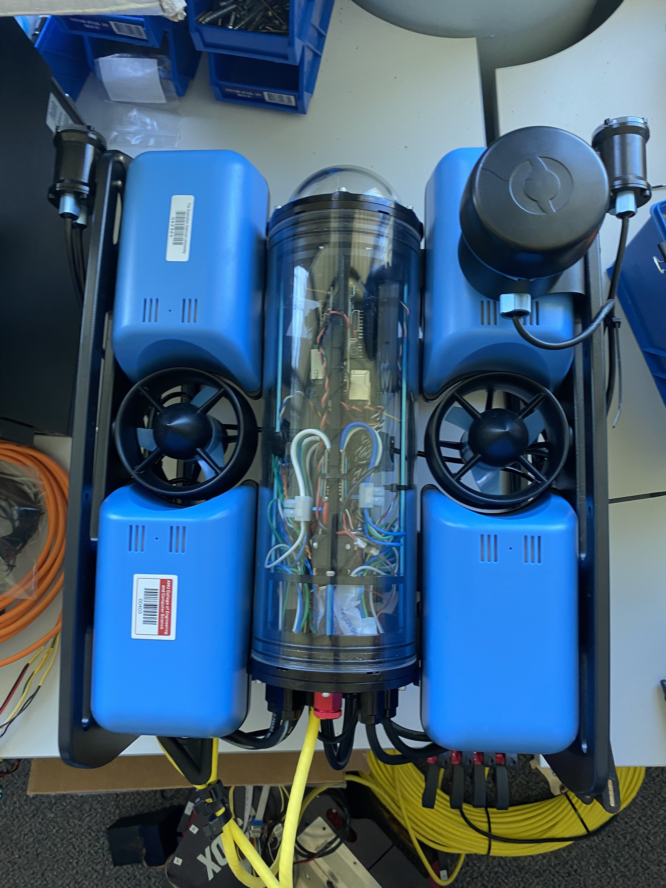
Multi-Beacon Ranging system for Underwater robotics
U5894374 Brian Ma
U7869326 Xingyu Luan
U7756428 Xiang Peng
U7559483 Yuqiao Xin
U7776558 Xu Ben
U7810272 Yuk Lam
U7757356 Yifan Wu

Slide 2
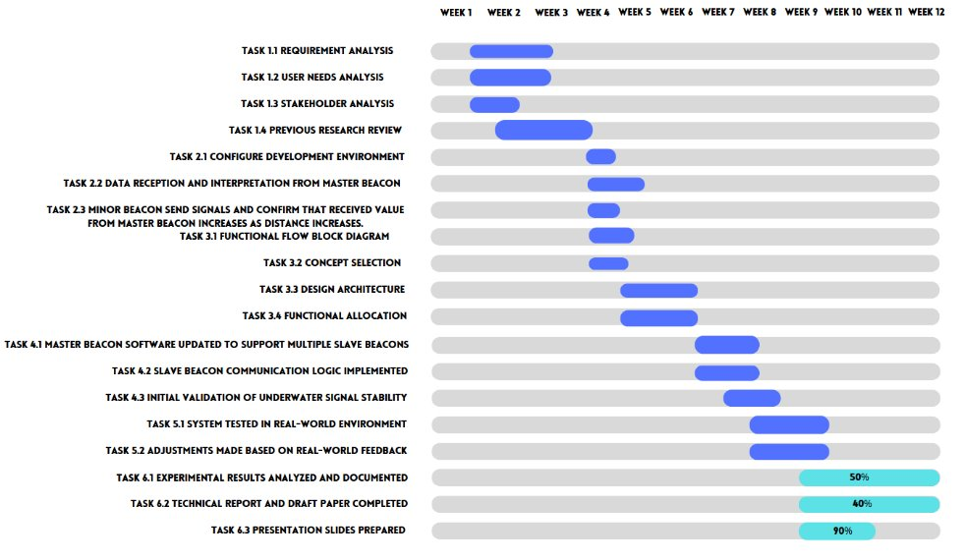
Current State

Slide 3
Decisions Made With Client
Week 7: We decided to develop a data transmission protocol, which is proposed by client
Week 8: Client suggests we run unit test on a separate stm32 board to speed up the development.
Week 9: We decided to test code on beacons instead and brought beacons home, which is granted by client.
week 10: Client was happy about the prototype, so we decide to conclude the project.

Slide 4
PrototypeIf receive a response
If no response​ in 1s
Master Beacon
Schedule request data packet
Deactivate peak detector
Enable echo count down
If receive a response​
Wait for response
Change the data to be send as the next beacon ID
Data packet
If data not matching ID
or data invalid
Response
Minor Beacons
On detecting the first pulse
Record each bit
Count for 15 bits
If data match its ID
Check Data
Send response pulse

Slide 5
Test Result
Unit Test
Data encoding and decoding algorithm 100% accracy
Functional Tests
Pulse train sending 100% accuracy
Pulse train receiving 91% accuracy
Echo inhibition 97% accuracy
Field Tests
Positioning test in fish tank 5.7% variation 1 positioning per second
Positioning test in lake 3.2%variation 1.3 positioning per second

Slide 6
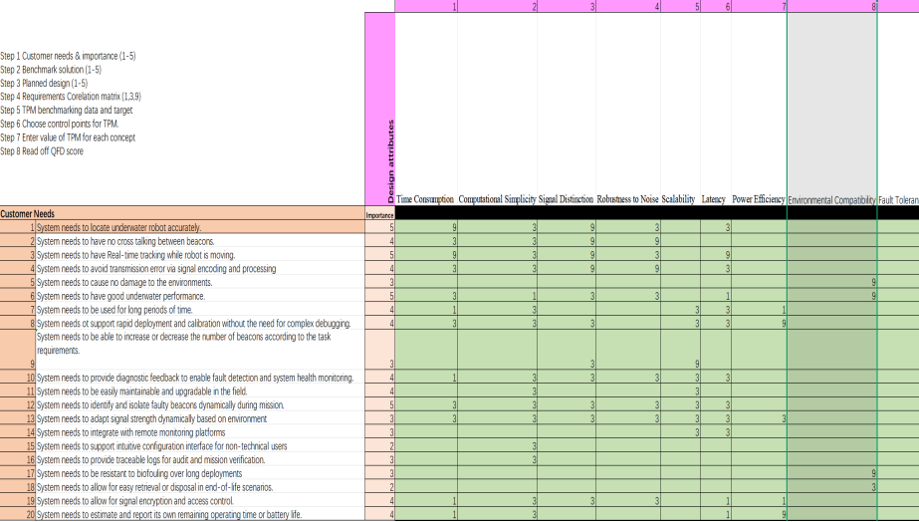
Design Validation (HoQ)

Slide 7
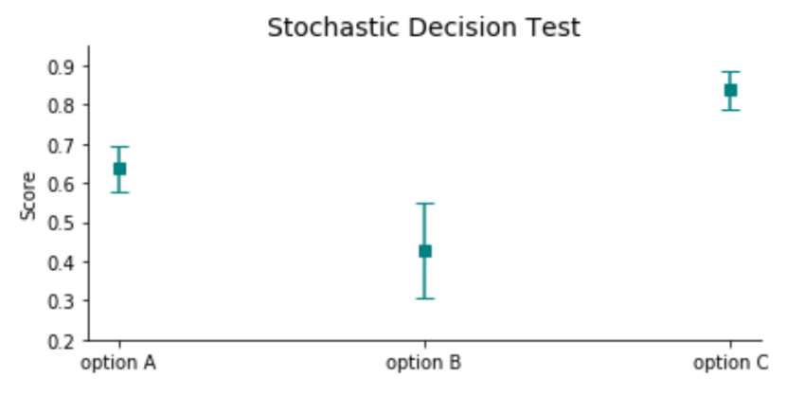
Design Validation
(Comparison based on HoQ score)
Option A:
Sonar based pulse train encoding
Option B:
GPS positioning
Option C:
Sonar based frequency encoding

Slide 8
Deliverables
Landing Page
Git Repository
Positioning Firmware

